Slide 1
Structural Strength Analysis of OTEC Turbine Under the Guidance of: DR. Prasad Dudhgaonkar [Scientist D] at NIOT Dr. R Vijayakumar ASSOC PROF at IITM Presented By Ankit Yadav OE18M008

Slide 2
Turbine in OTEC System
Very critical and important component of a power generation system.
Components undergo various loads but centrifugal loads are major
Loads do vary in time.
Failure of any component may cause serious damages
Critical Components:
Turbine Shaft
Disk and Blades
Turbine Configuration
Single stage
Axial flow turbine
Open Cycle
Design similar to Steam Turbine
Based on Design by NIOT

Slide 3
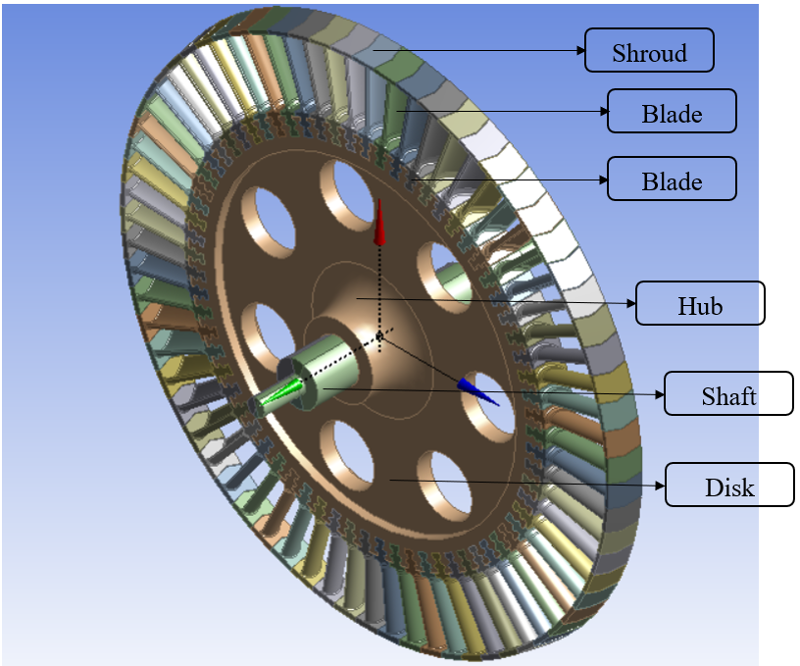
Objectives
Structural Analysis of Turbine Components and Assembly
Design of Shaft and Disk Assembly
Design of Blade Roots

Slide 4
Scope of the Project:
Finite Element analysis
Stress Analysis: -
Centrifugal Load: Applied using Rotational speed as Input
Operational Speed [3000 Rpm]
Design Speed [3800 Rpm]
Aerodynamic Load using Pressure Distribution
Modal analysis (For studying vibrational response)
Obtain Mode shapes and Natural Frequencies
Generate Campbell diagram
Obtain critical speed
Grid Independence Test
To Obtain optimal no of elements
To validate results
Selection of suitable design

Slide 5
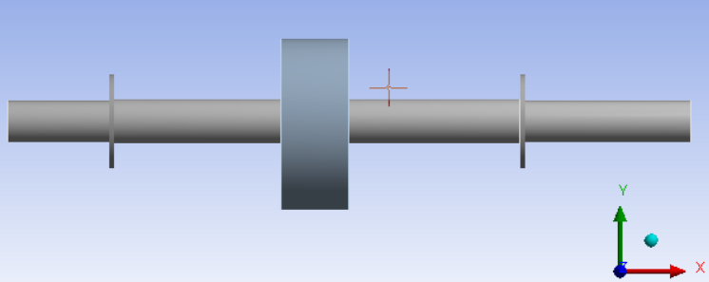

Model and Boundary Conditions
Shaft
L= 1m
d= 60mm (min)
Disc
D= 1.3 m
$I_{min}=$83.5 kg$m^{2}$
Blades
Z= 70
Load applied:
Centrifugal Load
Operational Speed (3000 Rpm)
Design Speed (3800 Rpm)
Pressure on Blade
Assembly Supported on Bearings
Translations are Constrained, Rotations Allowed

Slide 6
Validation Study
Aim:- To find the Natural Frequency and Mode Shape of Rotor and Shaft assembly and validation of results with different FEA tools for comparison and choose the best suitable one. Article Reference Shin-Yong Chen, Chieh Kung, Jung-Chun Hsu. 2011 Dynamic Analysis of a Rotary Hollow Shaft with Hot-Fit Part Using Contact Elements with Friction. Transactions of the Canadian Society for Mechanical Engineering. 35(3):461- 474
Shaft and Rotor assembly considered with given dimensions.
Rotor fitted on shaft with interference fit of 0.028mm.
Both considered flexible type.
Surface to surface Frictional contact provided with COF= 0.029 & 0.0745
Similar Meshing and Analysis settings are used as in Literature.
Modal analysis performed with free-free boundary condition to find natural frequency of the system.
Two mode shapes are validated with the literature.

Slide 7
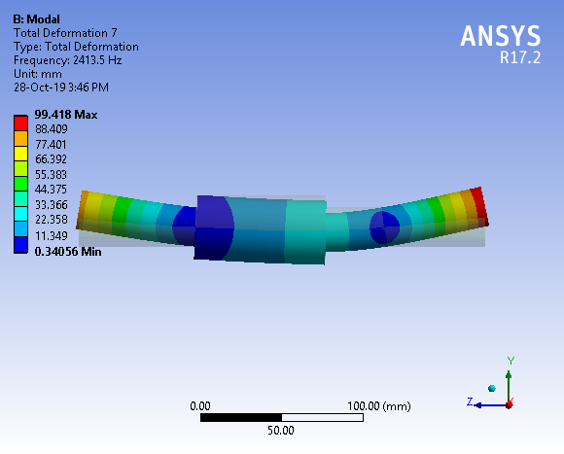
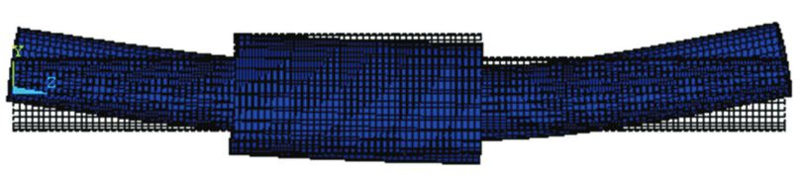
Results Comparison
First Mode shape
Result obtained
cof= 0.029 fn= 2397.7 hz
cof= 0.0745 fn= 2413.5 hz
cof= 0.029 fn= 2384.05 hz
cof= 0.0745 fn= 2396.39 hz
Model testing fn= 2379.71 hz
(experiment)

Slide 8
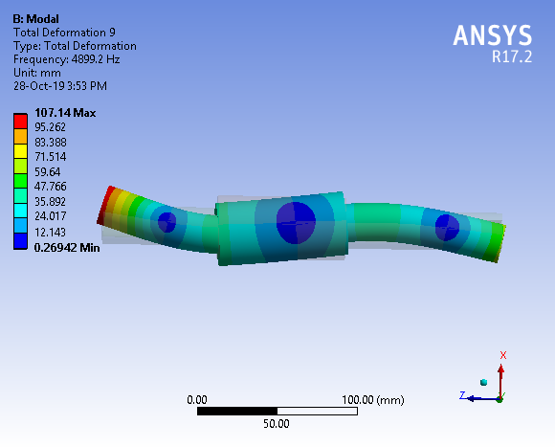
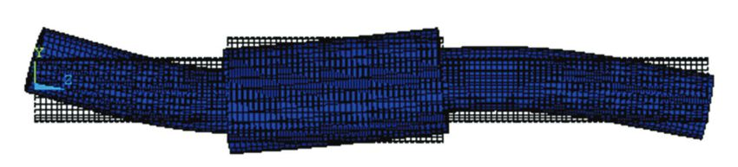
Results Comparison
Second Mode shape
Result obtained
cof= 0.029 fn= 4870.8 hz
cof= 0.0745 fn= 4899.2 hz
cof= 0.029 fn= 4871.68 hz
cof= 0.0745 fn= 4892.74 hz
Model testing fn= 4849.32 hz
(experiment)

Slide 9
Comparison of Prediction by Various Tools
Ansys Mechanical was selected.
Natural Frequency (hz) | REFERENCE | ANSYS MECHANICAL | APDL MECHANCIAL | ABAQUS
COF= 0.029/ First Mode
EXP | 2379.71
NUM | 2384.05 | 2397.7 | 2421.72 | 2428.8
Diff | 0.18% | 0.76% | 1.76% | 2.06%
COF= 0.029/ Second Mode
EXP | 4849.32
NUM | 4871.68 | 4870.8 | 4911.5 | 4926.9
Diff | 0.46% | 0.45% | 1.28% | 1.6%

Slide 10
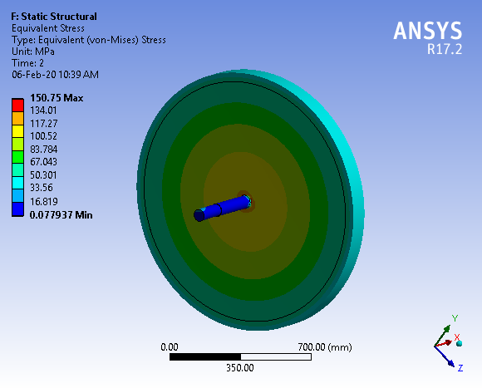
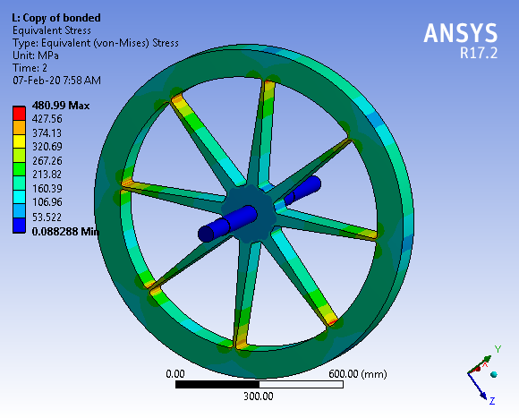

Configuration 1
Design of Disk
Configuration 2
Disk, $D_{o}=1.3m$
M= 887.8 kg, $I_{x}=159.8 kgm^{2}$ M= 358kg, $I_{x}=86.4kgm^{2}$

Slide 11
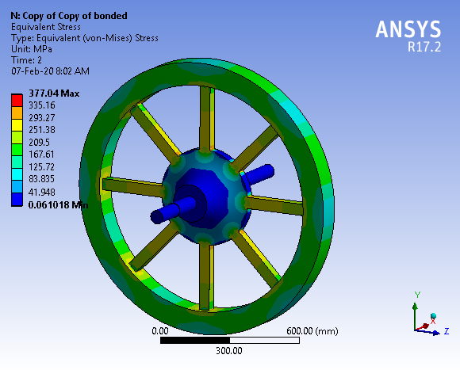
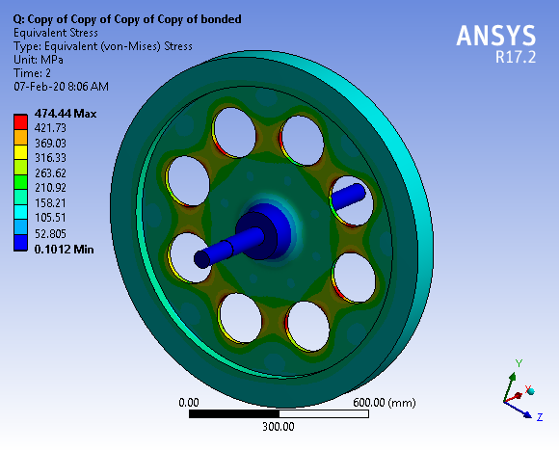

Configuration 3
Configuration 4
Disk, $D_{o}=1.3m$
M= 421kg, $I_{x}=87.94kgm^{2}$ M= 384kg, $I_{x}=91.8kgm^{2}$

Slide 12
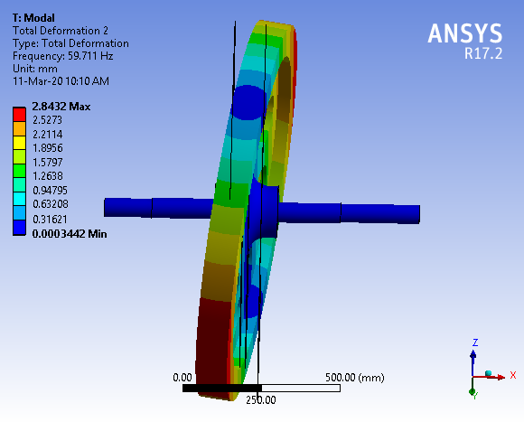
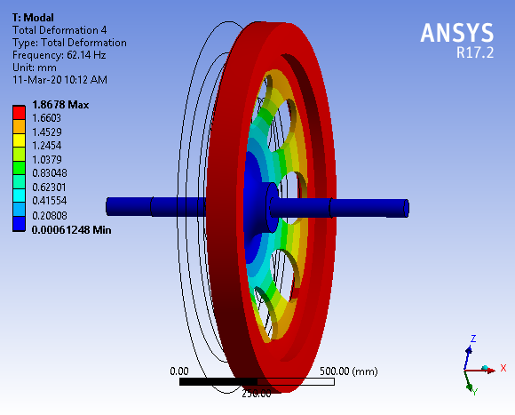
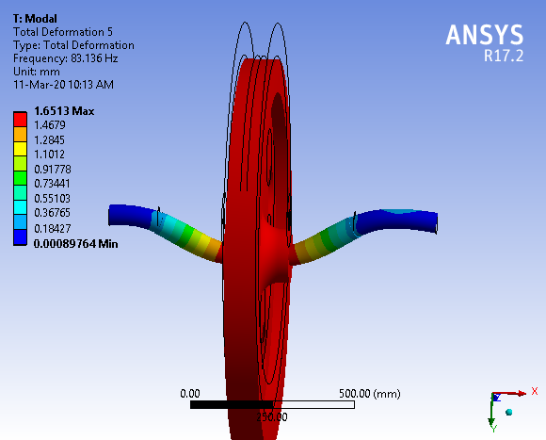
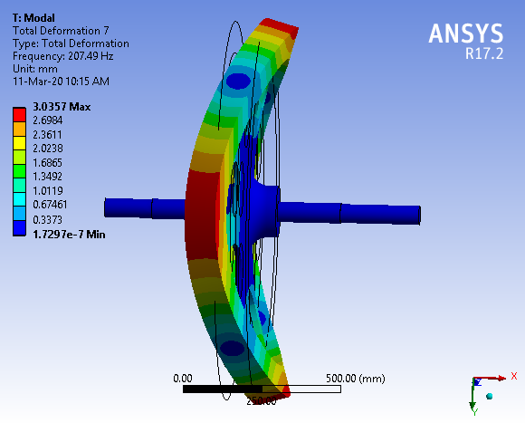
59.711 Hz
62.14 Hz
83.136 Hz
207.5 Hz

Slide 13
Design Refinements of Selected Configuration
S.No | Shaft Día (mm) | No of Holes | Hub Dia (mm) | Hub length (mm) | Disk width (mm) | Disk Inertia (Kgm^2) | Mass of Disk (Kg) | Critical Speed (Rpm) | Max Stress at Operation speed (MPa) | Total Def. (mm)
1 | 64 | 8 | 284 | 200 | 20 | 91.86 | 385 | 3582.6 | 474.44 | 0.42
2 | 80 | 8 | 475 | 300 | 40 | 104.87 | 537.84 | 2897.4 | 371.69 | 0.31
3 | 100 | 8 | 460 | 330 | 70 | 140 | 689 | 3969.1 | 351.23 | 0.33
4 | 100 | 8 | 460 | 330 | 60 | 132 | 636.56 | 3703.1 | 380.05 | 0.35
5 | 100 | 0 | 460 | 300 | 40 | 112 | 602 | 3596.4 | 155.36 | 0.21
6 | 100 | 8 | 460 | 200 | 40 | 101.3 | 524 | 3252.6 | 445.83 | 0.41
7 | 150 | 8 | 440 | 300 | 50 | 114 | 575 | 4319.5 | 305.61 | 0.36
8 | 150 | 7 | 440 | 300 | 50 | 116 | 588 | 4337.8 | 280.1 | 0.36
9 | 150 | 7 | 440 | 300 | 60 | 117.57 | 614.89 | 4809.8 | 249.43 | 0.37

Slide 14
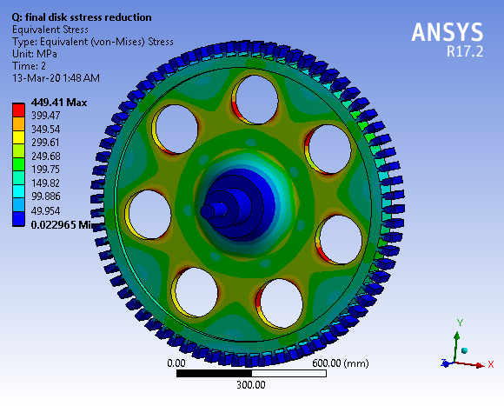
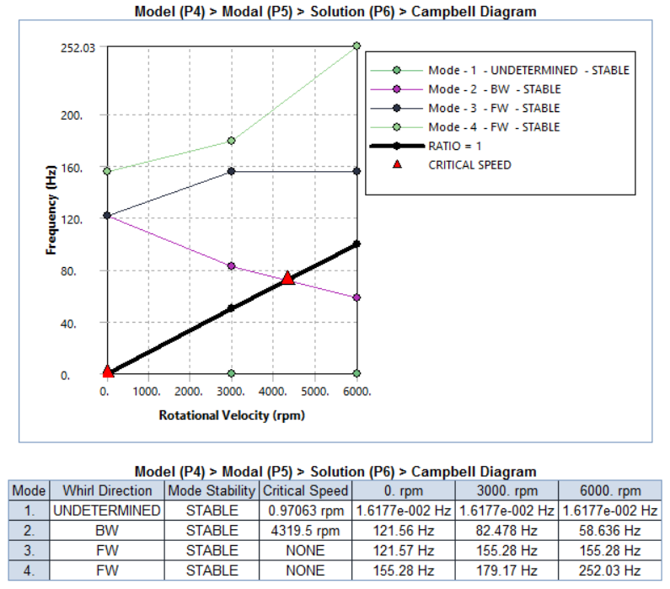
Static & Rotordynamic Analysis of Final Design
 | Operational Speed | Design Speed
 | 3000 RPM | 3800 RPM
Stresses | 280.1 Mpa | 449.41 Mpa

Slide 15
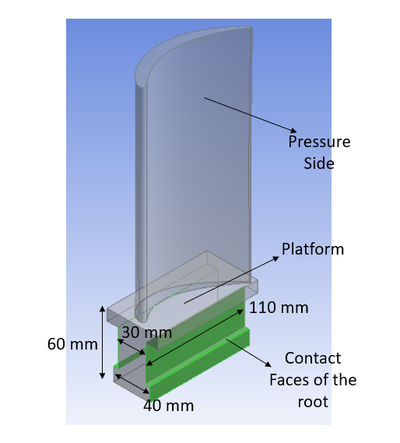
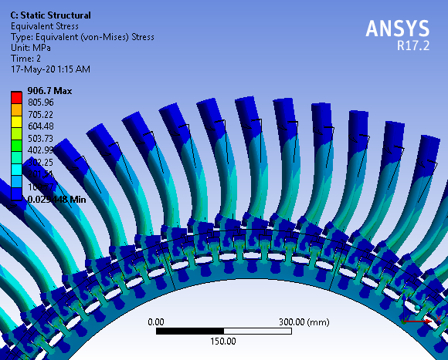
Design & Analysis of Blade Roots, T- type
Loads=> | Operational Speed 3000 RPM | Design Speed 3800 RPM
Stresses | 566.45Mpa | 906.7 Mpa
Total Def. | 0.25 mm | 0.40 mm

Slide 16
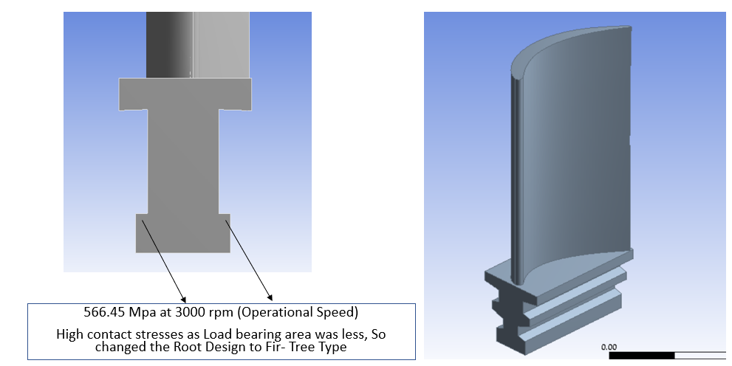
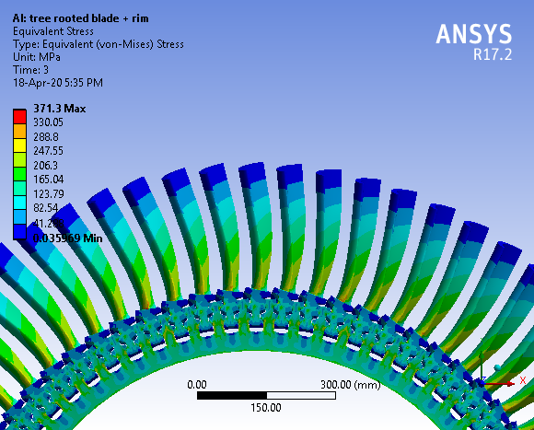
Improvement to Fir-Tree type Roots
Loads=> | Operational Speed 3000 RPM | Design Speed 3800 RPM
Stresses | 231.16 Mpa | 371.3 Mpa
Total Def. | 0.18 mm | 0.28 mm

Slide 17
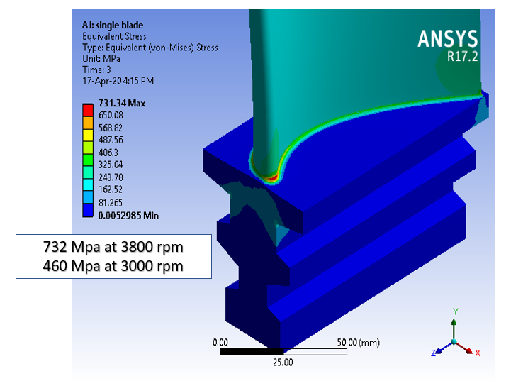
Single Blade Analysis and Effect of Fillet

Slide 18
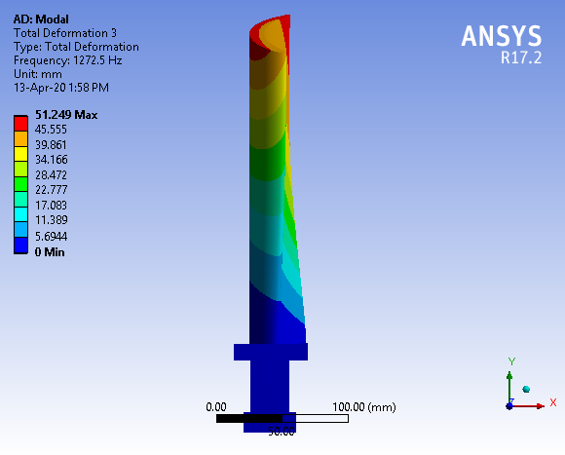
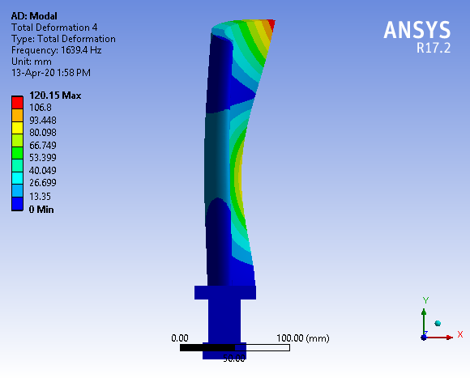
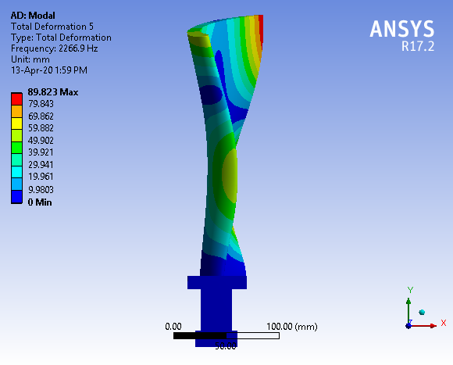
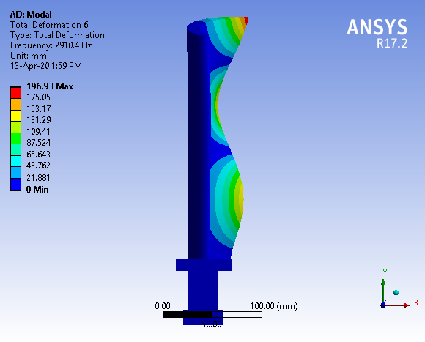
Blade Mode shapes & Natural Frequencies
1272.5 Hz
1639.4 Hz
2266.9 Hz
Quite close to excitation Fr i.e. 2050 Hz
2910.4 Hz

Slide 19
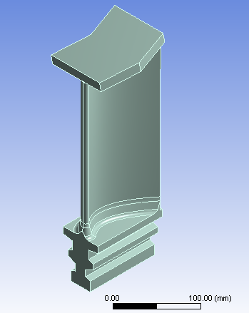
Effect of Shroud on Blade
Effect of shroud thickness on the blade is studied.
Shows Natural Frequencies being varied with shroud.
Increases the centrifugal stresses as well.
So thickness has to be minimum
Shroud Thickness | Operation Speed | Natural Frequencies (Hz)
 | Stress (Mpa) | f1 | f2 | f3 | f4 | f5 | f6
6mm | 640.14 | 264.35 | 540.5 | 1042.4 | 1429.9 | 1956.1 | 2306.3
8mm | 516.76 | 243.05 | 499.8 | 961.91 | 1400 | 1927.6 | 2509
10mm | 450.79 | 225.85 | 466.9 | 896.22 | 1371.1 | 1896.6 | 2638.4
12mm | 403.19 | 211.54 | 439.7 | 841.33 | 1343.7 | 1871.4 | 2711.9
14mm | 380.54 | 199.38 | 416.5 | 794.52 | 1317.6 | 1851 | 2749.9
16mm | 399.31 | 188.91 | 396.7 | 753.95 | 1293.1 | 1835.5 | 2768.7

Slide 20
Conclusion & Summary
A Validation study was done for comparing various FEA Tools & Found ANSYS Mechanical more suitable for our work
Configuration 4: Disk with holes, was selected for the design refinement
Effect of various parameters involved in the design were studied on the basis of Critical speed, max equivalent stress, total deformation criteria with required inertia and lesser weight.
For final design, obtained critical speed of 4319.5 Rpm is away from operation and design speed, max equivalent stress of 280 Mpa < yield strength of material with small Radial def. of 0.356 mm
Two type of blade roots were compared and found Fir-tree roots showing smaller contact stresses with the disk than T-type roots.
Analysis of blade shows large stress concentration at the blade and blade roots junction.
Addition of fillet to the junction increased the strength and reduced the stresses significantly.
From Modal Analysis, one mode shape showed natural frequency close to excitation frequency
For varying the natural frequency either blade thickness can be varied or shroud can be added.
Shroud with various thickness were analyzed which showed shift in natural frequency but increase in centrifugal stresses as well.

Slide 21
Thank You

